Slide 1



Research Works
Shen Yuan
2023-7-20

Slide 2
Main Research Works
ImDrug: A Benchmark for Deep Imbalanced Learning in AI-aided Drug Discovery. Submitted to IEEE TPAMI.
From Transformer to Sliceformer: Make Multi-Head Attention as Simple as Sorting. Submitted to NeurIPS 2023.
Modeling Hierarchical Graph-based Autoregressive Retrosynthesis with Statistically-interpretable Data Augmentation.

Slide 3
Main Research Works
ImDrug: A Benchmark for Deep Imbalanced Learning in AI-aided Drug Discovery. Submitted to IEEE TPAMI.
From Transformer to Sliceformer: Make Multi-Head Attention as Simple as Sorting. Submitted to NeurIPS 2023.
Modeling Hierarchical Graph-based Autoregressive Retrosynthesis with Statistically-interpretable Data Augmentation.

Slide 4
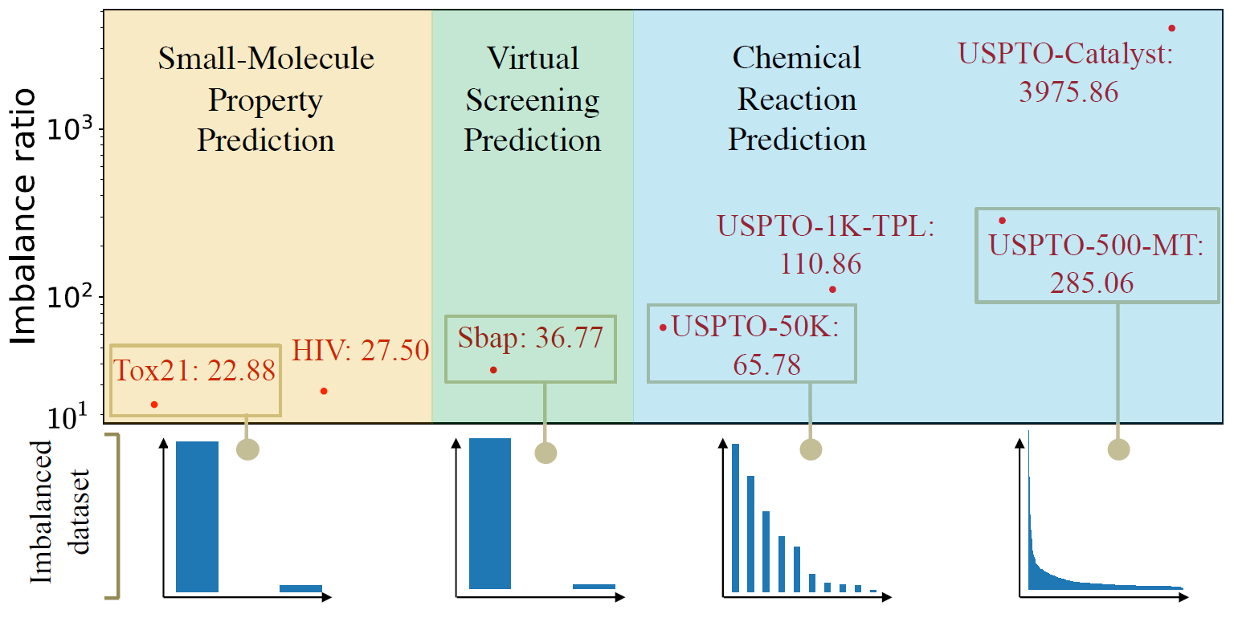
Motivation
Many drug datasets commonly exhibit severe imbalanced distribution problems, which can cause models to overfit on the head classes while underfitting the tail classes.
Deep imbalanced learning aiming to address the imbalanced problems, remains relatively understudied on the drug datasets.

Slide 5
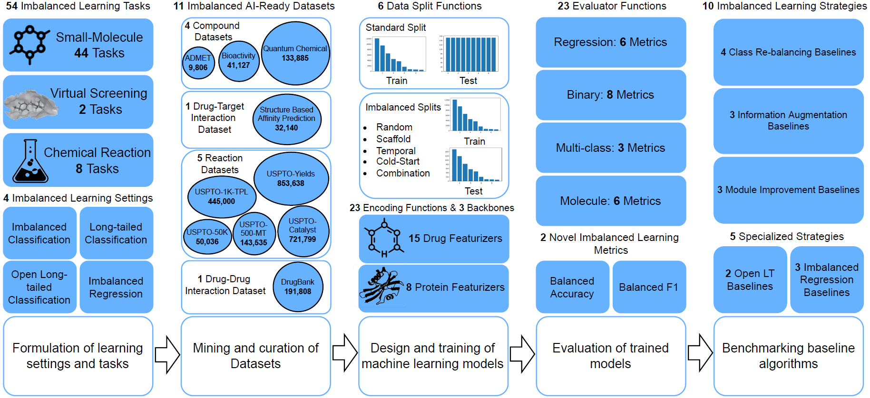
The Overview of ImDrug
https://github.com/DrugLT/ImDrug

Slide 6
Main Research Works
ImDrug: A Benchmark for Deep Imbalanced Learning in AI-aided Drug Discovery. Submitted to IEEE TPAMI.
From Transformer to Sliceformer: Make Multi-Head Attention as Simple as Sorting. Submitted to NeurIPS 2023.
Modeling Hierarchical Graph-based Autoregressive Retrosynthesis with Statistically-interpretable Data Augmentation.

Slide 7
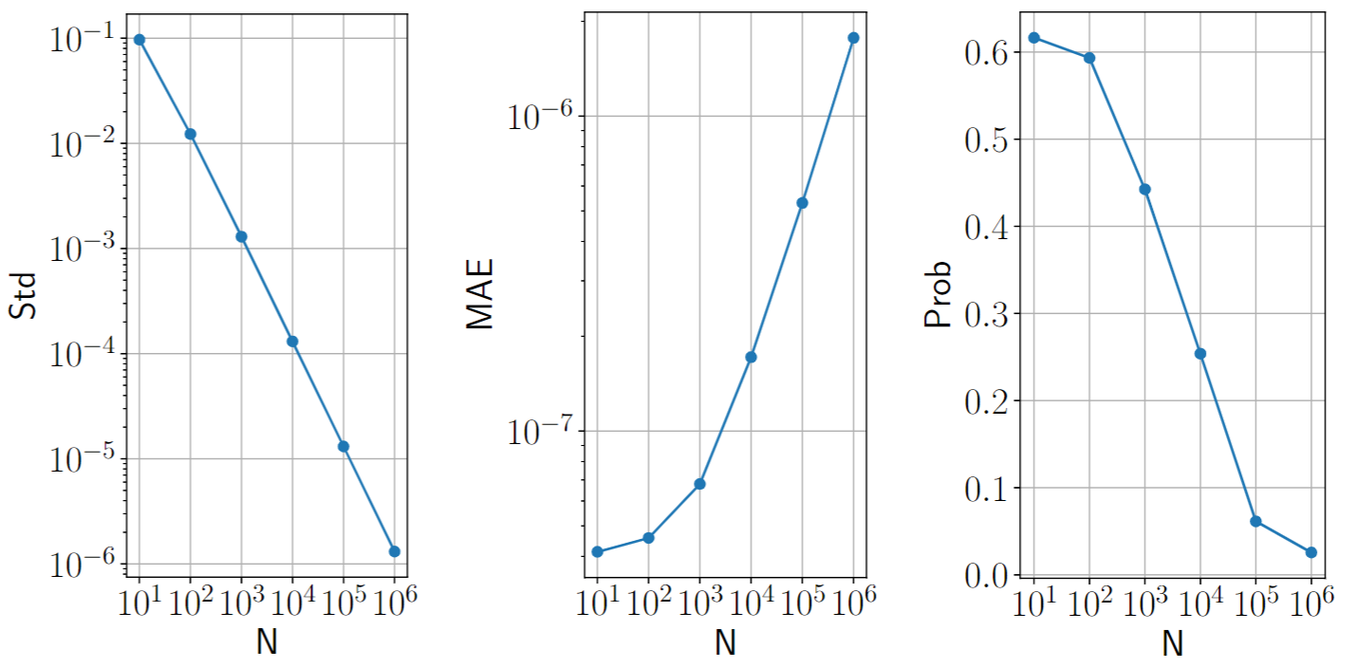
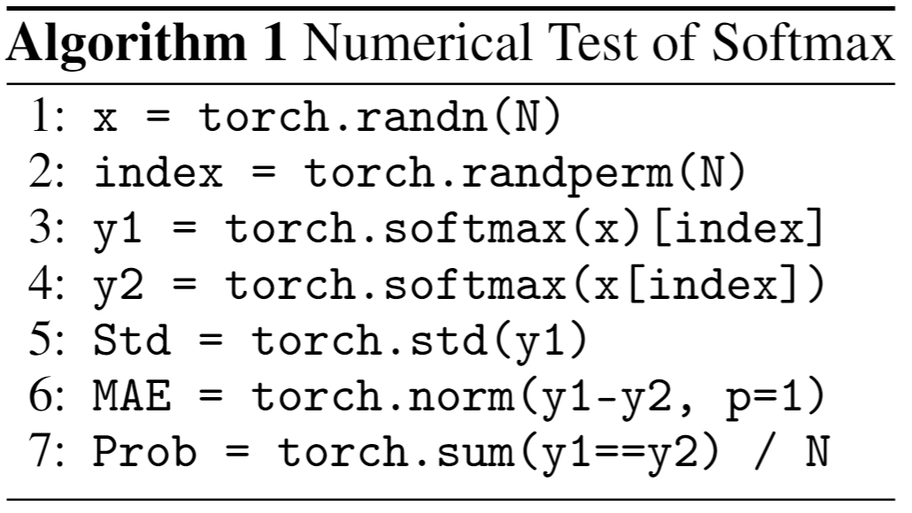
Challenge
The output of the softmax operation tends to be over-smoothed with the increase of data size.
The softmax operation exists as a numerical issue rarely mentioned in existing works, called the ``destruction of permutation-equivariance (DPE)''.

Slide 8
Method
Replaced with

Slide 9
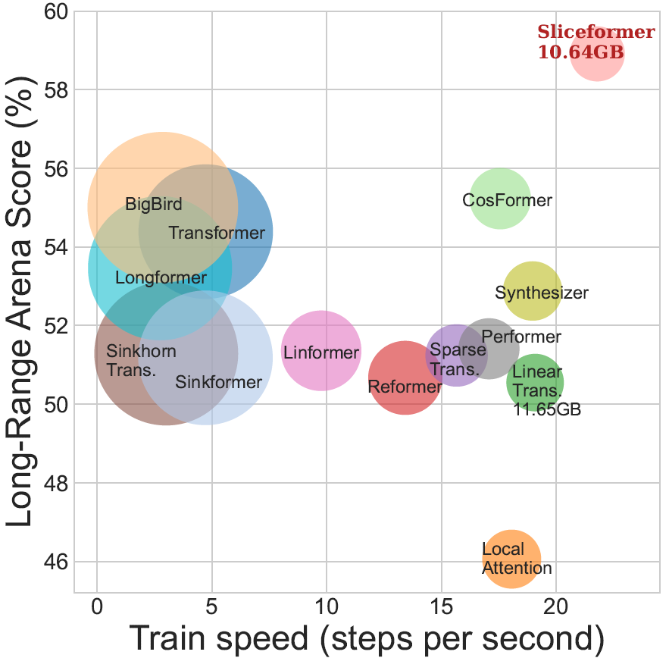
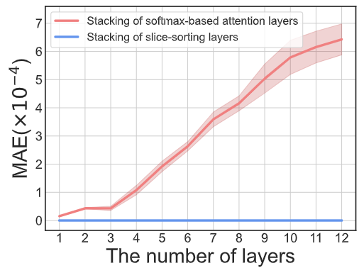
Experiments

Slide 10
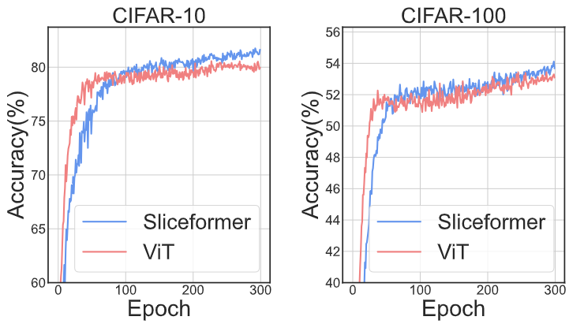
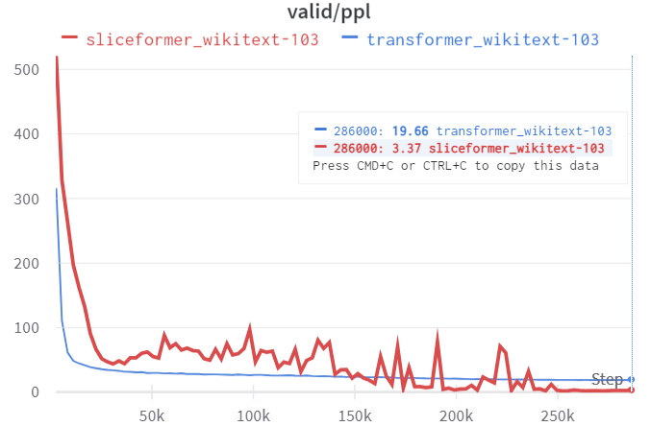
Experiments

Slide 11
Main Research Works
ImDrug: A Benchmark for Deep Imbalanced Learning in AI-aided Drug Discovery. Submitted to IEEE TPAMI.
From Transformer to Sliceformer: Make Multi-Head Attention as Simple as Sorting. Submitted to NeurIPS 2023.
Modeling Hierarchical Graph-based Autoregressive Retrosynthesis with Statistically-interpretable Data Augmentation.

Slide 12
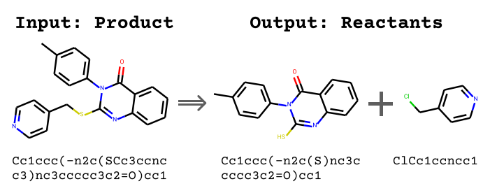
Molecule Retrosynthesis Prediction
In the field of AI-aided Drug Discovery, Molecule Retrosynthesis Prediction is one of the fundamental problems.
Given the target product, the task is to predict the candidate reactants.

Slide 13
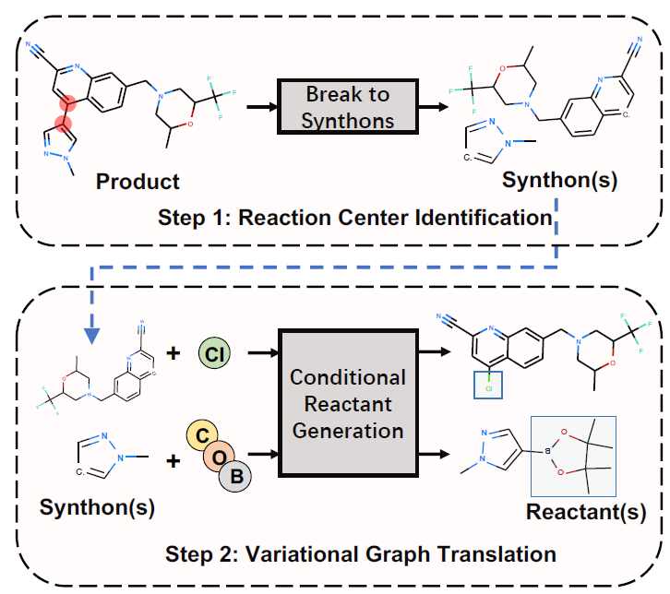
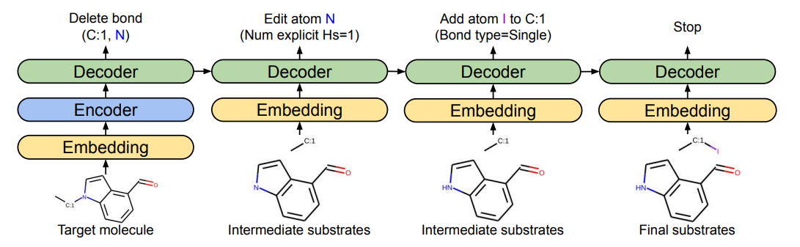
Challenge
Dataset Challenge: The generalization power of the current methods is unsatisfactory due to the insufficiency of the retrosynthesis dataset.
Modeling Challenge: Many methods either predict reactants directly or add atoms to synthons.
Sacha, Mikołaj, et al. "Molecule edit graph attention network: modeling chemical reactions as sequences of graph edits." Journal of Chemical Information and Modeling 61.7 (2021): 3273-3284.
Shi, Chence, et al. "A graph to graphs framework for retrosynthesis prediction." International conference on machine learning. PMLR, 2020.

Slide 14
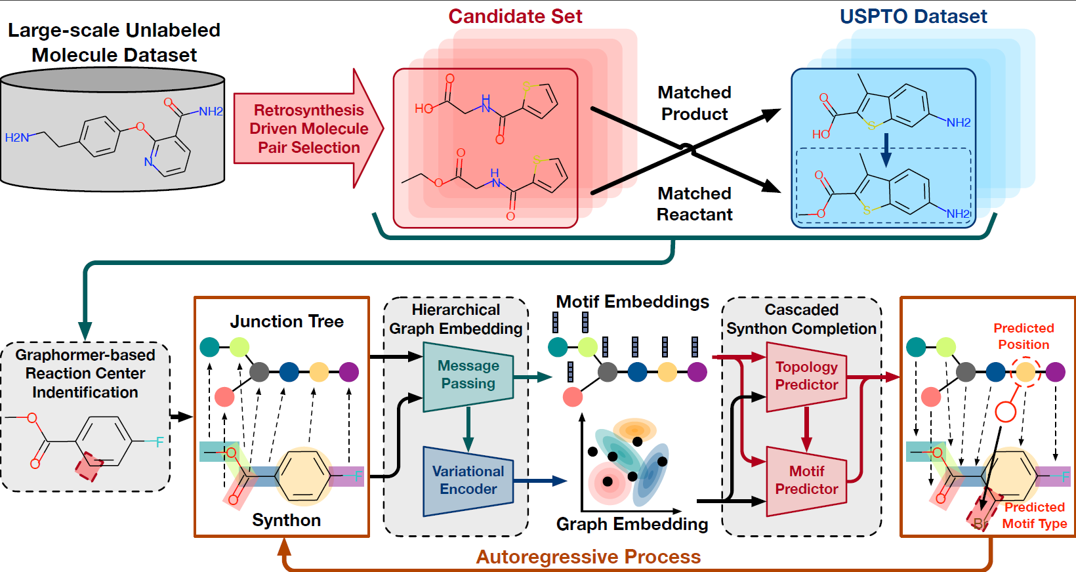
The Overview of HGA

Slide 15
Thank you for listening!
Shen Yuan
2023-7-20

